Slide 1
Welcome to ICSE 2020

Slide 2
Information
The ICSE website https://conf.researchr.org/home/icse-2020 has links to the following helpful documents
A high-level “map” of the overall program schedule
The detailed program schedule
A video providing details on how to participate in ICSE 2020
Access to ICSE 2020’s Twitter feed and Facebook page
Detailed information about presentations and papers (under “Tracks”)

Slide 3
We Thank our Supporters and Sponsors:

Slide 4




Platinum-level Supporters

Slide 5









Gold-level Supporters
Silver-level Supporters
Bronze-level Supporters

Slide 6





Sponsors

Slide 7
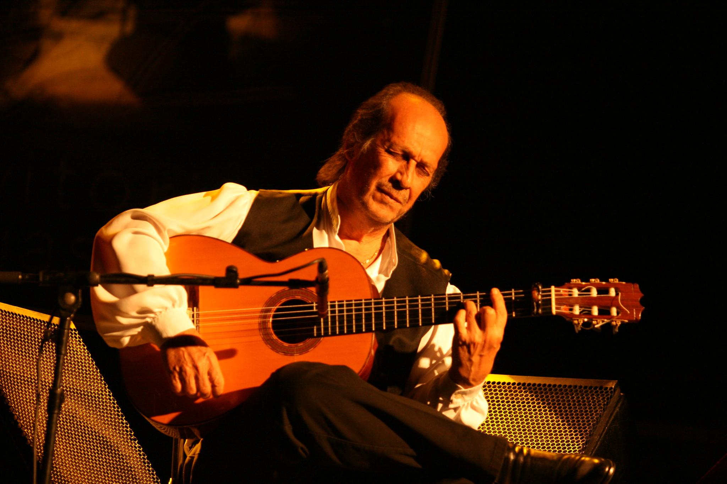
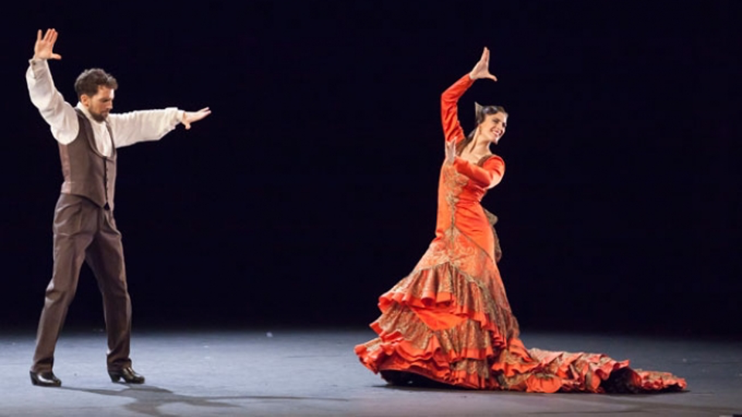

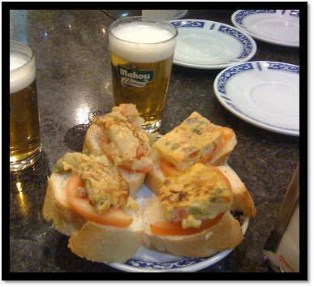
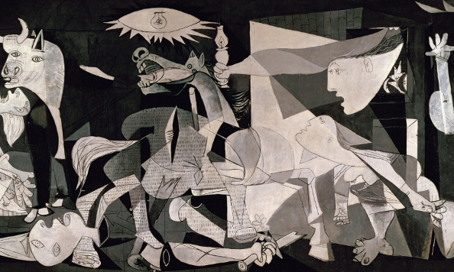

The 43rd International Conference on Software Engineering
May 23-29, 2021 (Main Conference Tue 25-Thu 27)
The 43rd International Conference on Software Engineering (ICSE 2021)
May 23-29, 2021
Main conference Tue 25-Thu 27
Madrid, Spain
Madrid (Spain)

Slide 8

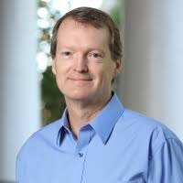
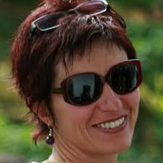
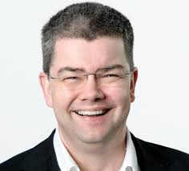
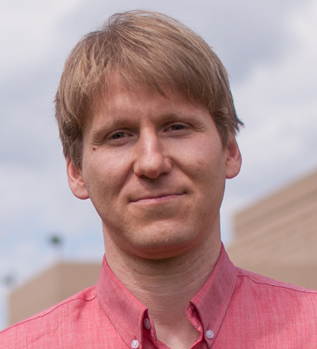
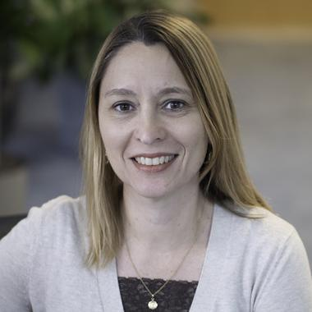
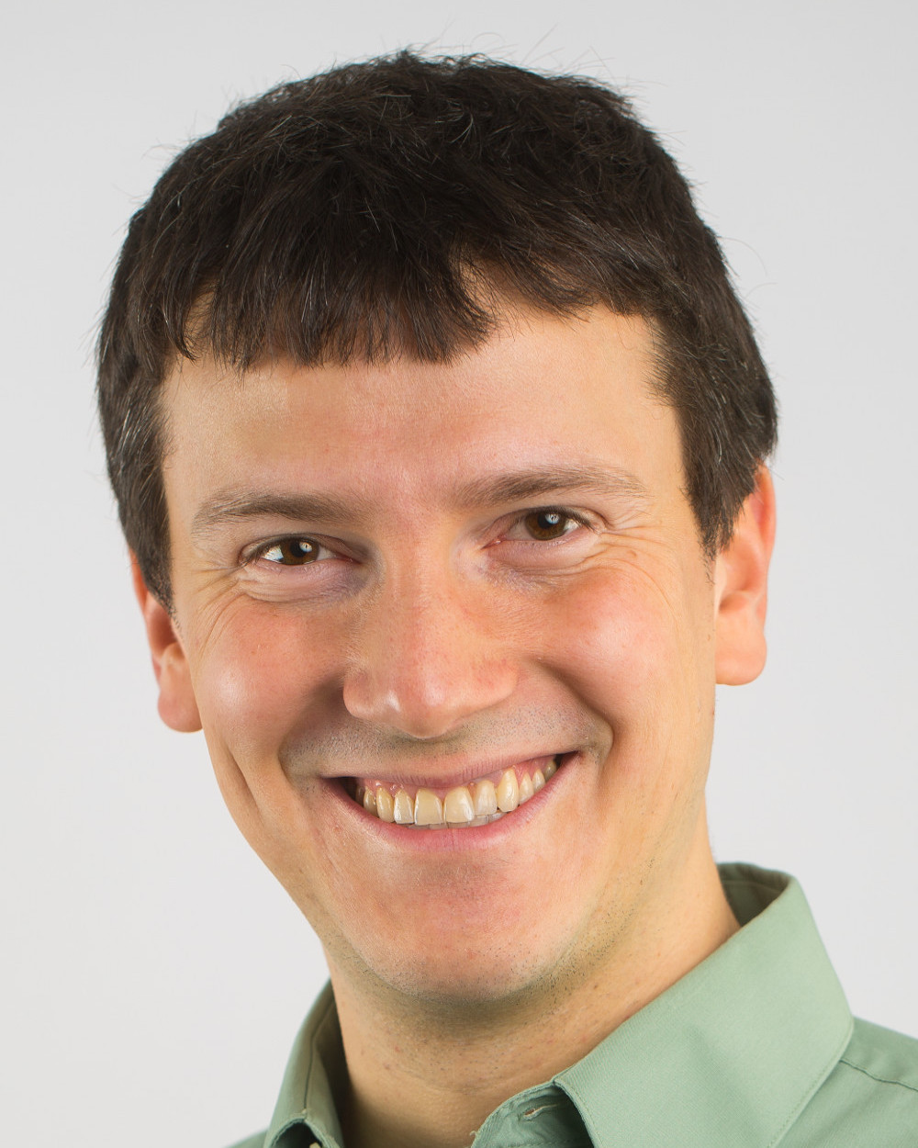
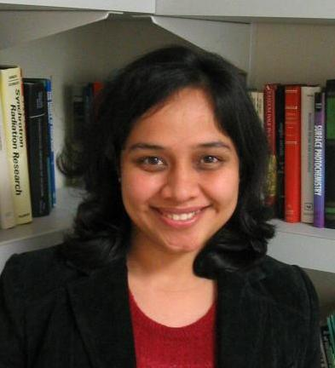
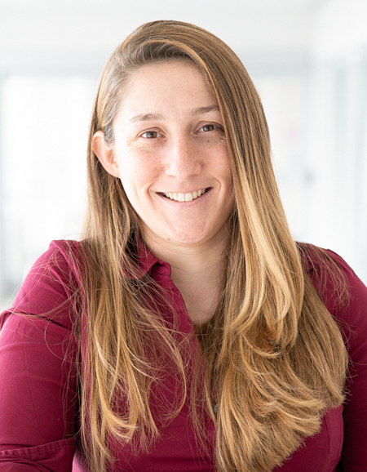
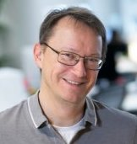
The 44th International Conference on Software Engineering
May 21-29, 2022
Pittsburgh, Pennsylvania, USA
Join us…

Slide 9
Did you Know? ICSEs “Virtual Rooms” are Named after Historical Korean Kingdoms: Baekje Goguryeo Silla Tamna

Slide 10


Slide 11


Slide 12


Slide 13


Slide 14
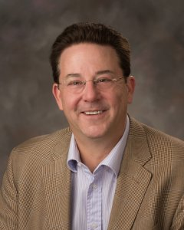
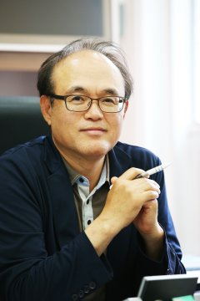
“We Thank the ICSE 2020 Organizing Committee”
Gregg Rothermel
General co-Chair
Doo-Hwan Bae
General co-Chair

Slide 15
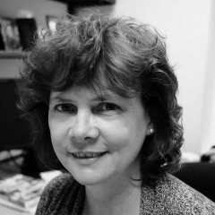
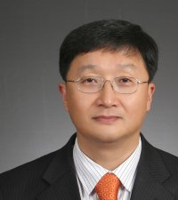
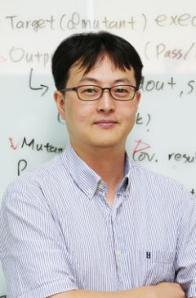
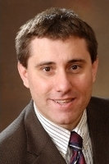
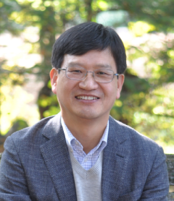
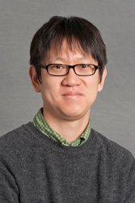
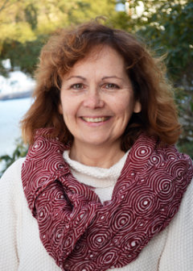
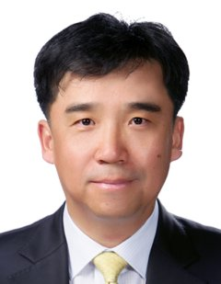
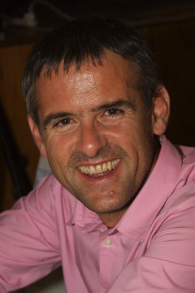
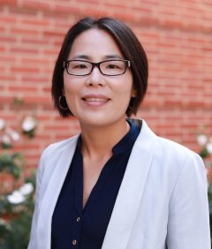
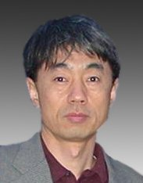
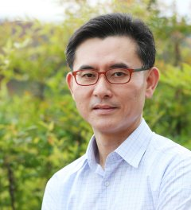
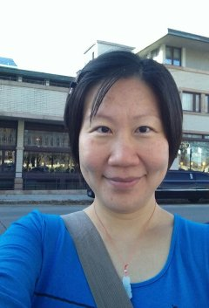
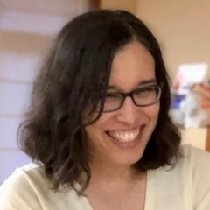
“We Thank the ICSE 2020 Organizing Committee”
Jane Cleland-Huang
Program co-Chair
Steve Cha
Co-Located Events co-Chair
Moonzoo Kim
SEIP Chair
Darko Marinov
Program co-Chair
Jang-Eui Hong
Korean Co-Located Events co-Chair
Shin Yoo
NIER co-Chair
Lori Pollock
Workshops co-Chair
Byungjeong Lee
Korean Co-Located Events co-Chair
Willem Visser
NIER co-Chair
Miryung Kim
Workshops co-Chair
Sungwon Kang
JSEET Co-Chair
In-Young Ko
Finance Chair
Wei Le
Co-Located Events co-Chair
Amy Ko
JSEET Co-Chair

Slide 16
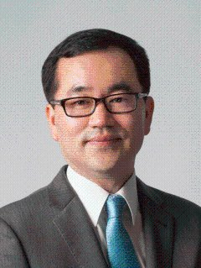
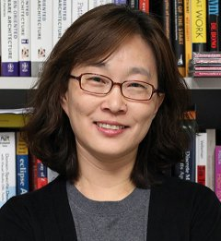
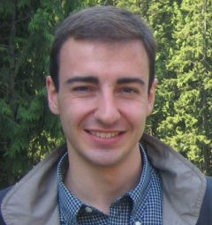
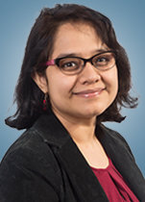
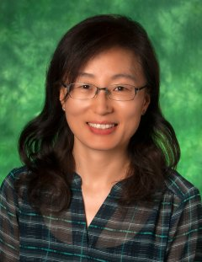
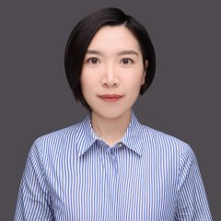
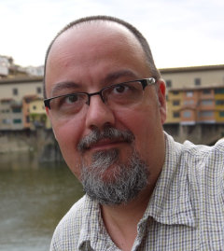
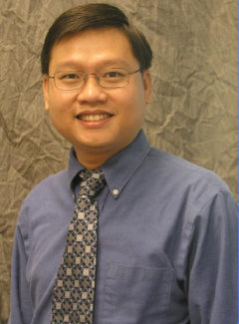
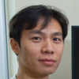
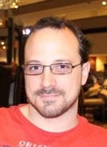
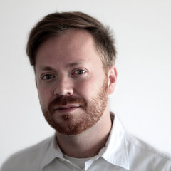
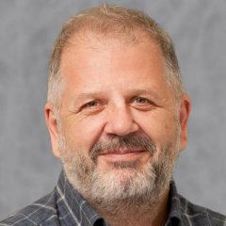
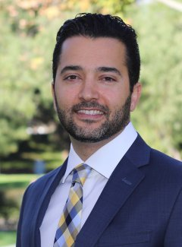
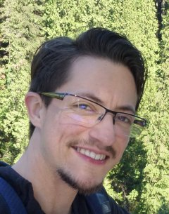
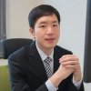
“We Thank the ICSE 2020 Organizing Committee”
Seok-Won Lee
SEIS co-Chair
Eunjee Song
Technical Briefings co-Chair
Collin McMillan
Poster Co-Chair
Anita Sarma
SEIS co-Chair
Hyunsook Do
Demonstrations co-Chair
Tingting Yu
Poster co-Chair
Andrian Marcus
Journal First co-Chair
Tien N. Nguyen
Demonstrations co-Chair
Xiangyu Zhang
Track Scheduling Chair
Mike Papadakis
Journal First co-Chair
Tim Menzies
Artifact Evaluation co-Chair
Ben Hermann
Registration Chair
Sam Malek
Technical Briefings co-Chair
Leandro Minku
Artifact Evaluation co-Chair
Yeong-Seok Seo
Exhibitions Chair

Slide 17
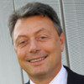
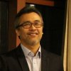
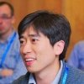
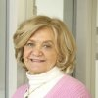
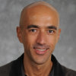
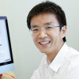









“We Thank the ICSE 2020 Organizing Committee”
Mauro Pezze
New Faculty Symposium Co-Chair
Junbeom Yoo
Student Research Competition co-Chair
Shin Hong
Web Co-Chair
Mary Lou Soffa
New Faculty Symposium Co-Chair
Alessandro Orso
Awards Chair
Lingming Zhang
Social Media co-Chair
Lionel Briand
Doctoral Symposium co-Chair
William G.J. Halfond
Proceedings co-Chair
Donghwan Shin
Social Media co-Chair
Gail Murphy
Doctoral Symposium co-Chair
René Just
Proceedings co-Chair
Prem Devanbu
MIP Award co-Chair
Andrew Begel
Student Research Competition co-Chair
Milos Gligoric
Web co-Chair
Sebastian Uchitel
MIP Award co-Chair

Slide 18















“We Thank the ICSE 2020 Organizing Committee”
Michael Vierhauser
Submissions Chair
Jongmoon Baik
Sponsorship Chair
Kyungmin Bae
Publicity co-Chair
Sang Kil Cha
Student Volunteer Co-Chair
Yunja Choi
Student Mentoring Workshop co-Chair
Eunjong Choi
Publicity co-Chair
José Miguel Rojas
Student Volunteer co-Chair
Christian Kästner
Student Mentoring Workshop co-Chair
Miran Lee
Publicity co-Chair
Hamid Bagheri
Student Volunteer co-Chair
Shane McIntosh
Student Mentoring Workshop co-Chair
Reda Bendraou
Publicity co-Chair
Carolyn Seaman
Student Volunteer co-Chair
Sandeep Kuttal
Travel Grants Chair
John L. Singleton
Publicity co-Chair

Slide 19











“We Thank the ICSE 2020 Virtualization Team”
Kihong Heo
Regional Live! Team Leader
David Shepherd
Social Events
Otavio Lemos
Youtube Team Leader
Sebastian Proksch
Regional Live! Team Leader
Kihong Heo
Social Events
Donghwan Shin
Youtube Team Leader
Iftekhar Ahmed
Regional Live! Team Leader
Paris Avgeriou
Social Events
Crista Lopes
Virtualization Chair
Oscar Dieste
Regional Live! Team Leader
Jonathan Bell Virtualization Technology
Xin Peng
Regional Live! Team Leader
Jeehoon Kang
Virtualization Technology

Slide 20













This livestreaming session brought to you by:
Yongjun Shin
Sangwon Hyun
Sumin Park
Jiyoung Song
Minyeop Choi
Zelalem Mihret
Young-Min Baek
Eunho Cho
SungJin Lee
Jeehoon Kang
Sang Kil Cha
Kihong Heo

